Slide 1

Fake News Classification
By:
Ria Maitra

Slide 2
Introduction
‘Fake news’, broadly defined as false or misleading information masquerading as legitimate information, is frequently asserted to be pervasive online with serious consequences for democracy
Fake news, lack of authenticity of information has become a major issue affecting businesses and society, both printed and digital media. At the time of crisis, fake news creates chaos and disturbances affecting people personal and professional life.
This paper examined the news context along with its headlines and author name to classify fake news. It is been observed that there is no relationship between author having highest frequency and fake news, authors Pam Key is observed to be the most authentic writer. More than 95% of his news are true.
The contexts of news and headlines are pre-processed with the help of tf idf, converting it into vectors
MultinomialNB, Knn, DecisionTree and RandomForest models are used for classification of fake news. Decision tree model is the best performing model with accuracy score of 89%.

Slide 3
Objectives
To find relationship between author of news article and fake news.
To build machine learning algorithms to classify fake news.

Slide 4
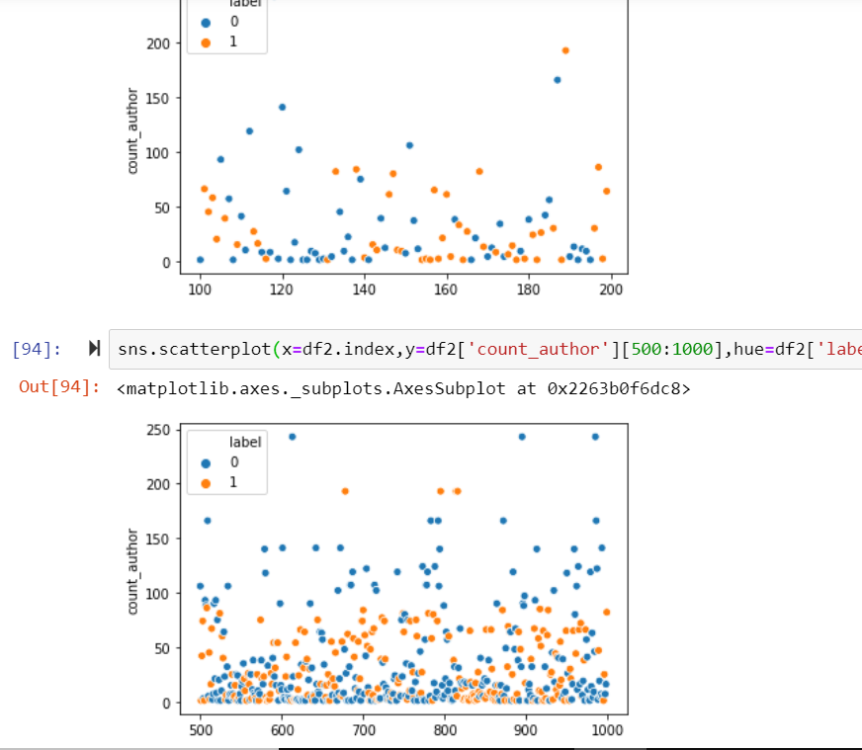
Univariate Analysis
Checking any trend of frequency of author and fake news through scatter plot

Slide 5
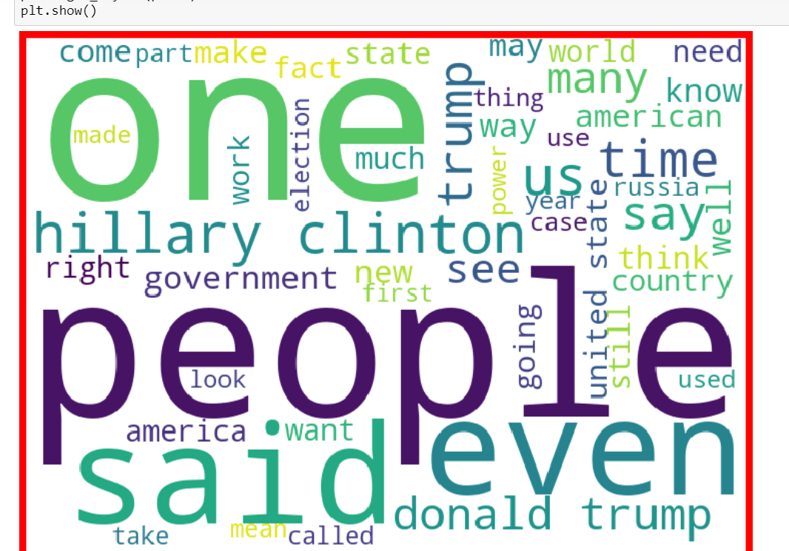
Checking loud words in fake news

Slide 6
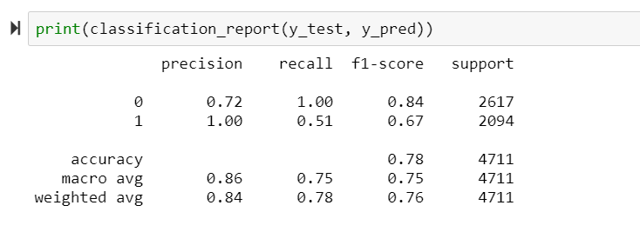
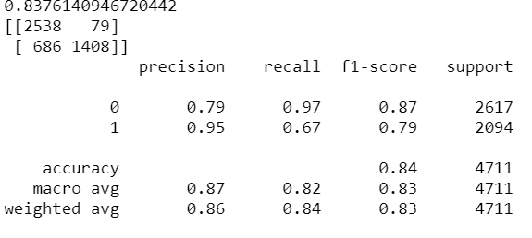
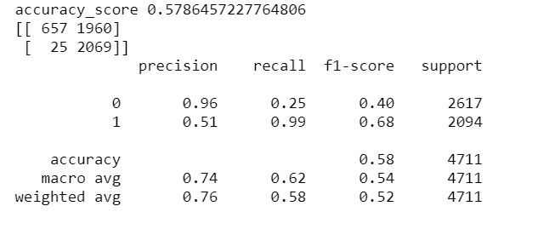
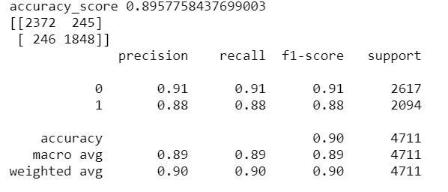
Model Deployment
RandomForest
MultinomialNB
Knn
DecisionTree

Slide 7
Model Performance
Model | Test_score
MultinomialNB | 0.781150
Knn | 0.578646
RandomForest | 0.837614
DecisionTree | 0.895776

Slide 8
Conclusion
From the above study it is been observed that there is no such trend or relationship between frequency of authors and fake news.
Also, it is been observed authors having no name, just having words like admin or no reply are sending fake news.
Authors Pam Key is observed to be most authentic author as his frequency of sending news is the highest and more than 95% news are true.
Decision Tree is the best performing model with accuracy score of 89%.
Mostly news is related to politics.
Subjects on Hilary Clinton and headline with Donald Trump are more prone to be a fake news.
In conclusion we can say that fake news is a major issue because it plays with people emotions disturbing a entire nation. Mostly when it comes to politics huge amount of fake news is spread, with the help of Machine Learning Algorithms we can minimize the spread. Also in this study Decision Tree model is the best performing model. This model can be used for detecting fake news.

Slide 9
Thank You

